Slide 1
THE MOTIVATION TO WORK
Chapter 8
1 | 2 | 3 | 4 | 5 | 6 | 7 | 8 | 9 | 10 | 11 | 12 | 13 | 14 | 15 | 16 | 17 | 18 | 19 | 20
21 | 22 | 23 | 24 | 25 | 26 | 27 | 28 | 29 | 30 | 31 | 32 | 33 | 34 | 35 | 36 | 37 | 38 | 39 | 40
41 | 42 | 43 | 44 | 45 | 46 | 47 | 48 | 49 | 50 | 51 | 52 | 53 | 54 | 55 | 56 | 57 | 58 | 59 | 60
61 | 62 | 63 | 64 | 65 | 66 | 67 | 68 | 69 | 70 | 71 | 72 | 73 | 74 | 75 | 76 | 77 | 78 | 79 | 80

Slide 2
Overview
Module 8.1 – Introduction to Motivation
Modules 8.2 & 8.3 – Theories of Motivation
Module 8.4 – Practical Issues in Motivation

Slide 3
Introduction to Motivation
Module 8.1

Slide 4
Motivation
Why is motivation important?
Fewer than 1 in 4 jobholders believe they work at their full potential
1 in 2 put in only the amount of effort necessary to keep their job
60% of Americans don’t think they work as hard as they used to

Slide 5
What Is Motivation?
Motivation is the combined effects on behavior of 3 choices (facets):
Direction –
Intensity –
Persistence –

Slide 6
How does motivation fit into the “big picture”?
Select
Train
Motivate
“Can”
“Will”

Slide 7
Does Motivation → Performance?
Motivation is only 1 factor that affects performance
For example, ability level moderates the relationship (more motivation doesn’t always lead to better performance)
High ability
Low ability
Motivation
Performance
Performance
Ability
Motivation

Slide 8
Which matters most?
Where can I/O psychologists have impact?
Performance = (ability x motivation) – situational constraints
Willingness
to
Perform
Capacity
to
Perform
Opportunity
to
Perform
PERFORMANCE

Slide 9
Brief History of Motivation Theory in I-O Psychology
First theories anchored motivation in notions of instincts (Freud)
“Instinct” gradually replaced by terms like need, motive, & drive (Maslow)
Behaviorist approach (Skinner)

Slide 10
Theories of Motivation
Modules 8.2 & 8.3

Slide 11
Theories of Motivation
Intuitively appealing theories that lack empirical support
Theories with empirical support, but limited practical utility
Theories with mixed support
Theories with strong support and practical utility.

Slide 12
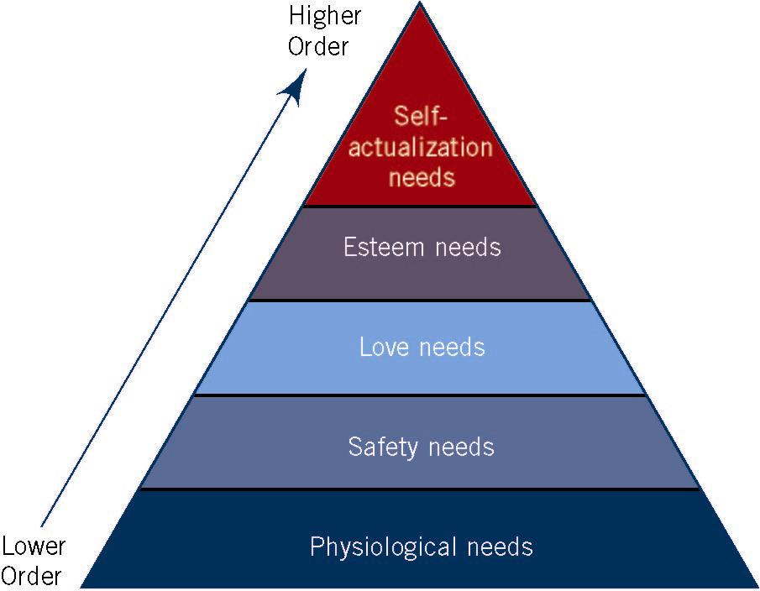
Intuitively appealing theories that lack empirical support
Maslow’s Hierarchy of Needs
Answers the question: What outcomes is an individual motivated to obtain from a job and an organization?
Popular, but not much support for more technical aspects

Slide 13
Intuitively appealing theories that lack empirical support
Herzberg’s 2-Factor Theory
Hygiene Needs
Related to job, is not work itself (e.g., pay, company policies)
Minimize employee dissatisfaction, doesn’t motivate
Motivator Needs
The work itself (e.g., challenging work, responsibility)
Gives satisfaction, motivates
Findings generally not replicated

Slide 14

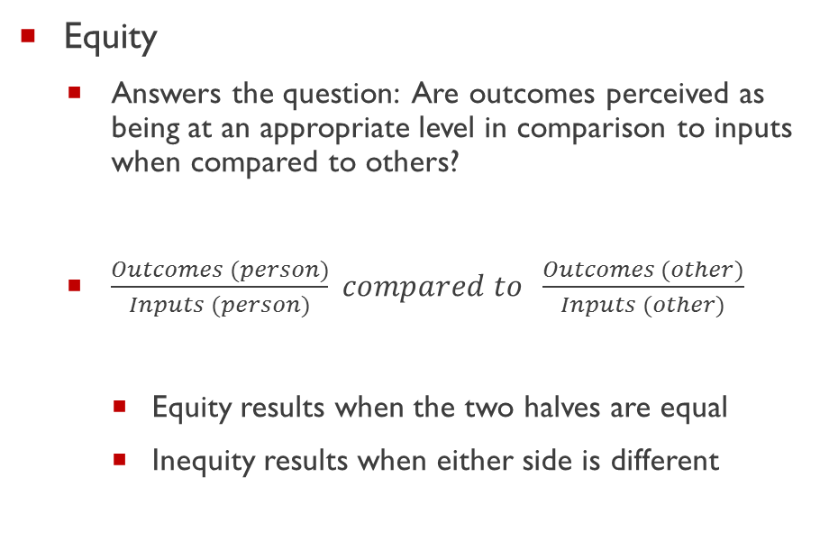
Theories with some empirical support but limited practical utility
Equity
Answers the question: Are outcomes perceived as being at an appropriate level in comparison to inputs when compared to others?
$\frac{Outcomes (person)}{Inputs (person)} compared to \frac{Outcomes (other)}{Inputs (other)}$
Equity results when the two halves are equal
Inequity results when either side is different
Example
$\frac{\$1500}{50 hours} ? \frac{\$800}{40 hours}$
30 > 20

Slide 15
Theories with some empirical support but limited practical utility
Equity theory (continued)
Theory predicts that:
Equity → Satisfaction
Over-reward → “Tension” (Guilt)
Under-reward→ “Tension” (Resentment)
Research shows stronger support for underpayment than overpayment predictions
Assumes we do a lot of complicated calculations

Slide 16
Theories with some empirical support but limited practical utility
Expectancy (VIE) Theory: Vroom
People will be motivated when they believe:
Effort → Performance (Expectancy)
Performance → Outcomes (Instrumentality)
Outcomes are valued (Valence)
Motivation = V * I * E
Assumes people are highly rational
Predicts choices for an individual better than it predicts the behavior of one individual as compared to another

Slide 17
Expectancy Theory Example
 | E | I | V | M
Erin | 0.5 | 1.0 | 10 | 5
Doug | 1.0 | 0.2 | 10 | 2
Jen | 1.0 | 1.0 | 3 | 3

Slide 18
Theories with mixed support
Reinforcement Theory/ Behavior Modification
Based on Skinnerian behaviorism
Operant conditioning
Stimulus → Response → Reward→ More likely to repeat behavior

Slide 19
Theories with mixed support
Reinforcement Theory/ Behavior Modification
Reinforcement often works but…
Requires detailed measurement of performance.
Usually applicable in low vs. high complexity jobs
Close monitoring of individual behaviors.
Feelings of control & manipulation.
Issues of ethical responsibility.

Slide 20
Theories with strong support and practical utility
Job Characteristics Model: _______________________________________
5 Core Job Dimensions:
Skill variety – using different skills, abilities, or talents.
Task identity – work from beginning to end.
Task significance – impact on the lives or work of other people.
Autonomy – freedom and independence for scheduling work and carrying it out.
Feedback – clear information about how effectively one is performing the job.

Slide 21
Theories with strong support and practical utility
The AT&T studies implemented job redesign projects (conducted by Robert Ford in the 60’s).
Results:
higher satisfaction
lower turnover
shorter response time (to customer)
higher quality responses

Slide 22
Job Characteristics Model (JCM)
CORE JOB
DIMENSIONS
CRITICAL
PSYCHOLOGICAL
STATES
PERSONAL
AND WORK
OUTCOMES
Skill variety
Task identity
Task significance
Experienced
meaningfulness
of the work
High internal
work motivation
High-quality
work performance
High satisfaction
with the work
Low absenteeism
and turnover
Experienced
responsibility
for outcomes
of the work
Autonomy
Knowledge of
the actual
results of the
work activities
Feedback

Slide 23
JCM continued
Equation for indexing the potential of a job to motivate (MPS: motivating potential score)
Growth Need Strength (GNS)
Individual difference variable – reflects a desire to fulfill higher order needs
Entire effect of JCM depends on it (GNS is a moderator)
JCM can be useful if it takes into account individual differences (e.g., GNS)
$$\text{MPS}\text{ = }\frac{(skill variety+task identity+task sig)}{3} ×autonomy×feedback$$

Slide 24
Theories with strong support and practical utility
Goal Setting Theory
Goals are motivating & lead to higher performance if they are SMART
Specific
Manageable
Attainable
Relevant
Time bound

Slide 25
Theories with strong support and practical utility
Goal Setting Theory
Goals work by:
directing attention to the goal
increasing effort level
encouraging task persistence
facilitating strategies to overcome hurdles
Assumes you have the ability, are committed, and get feedback

Slide 26
Effect of Goals on Motivation
Percentage of Maximum Weight Carried on Each Trip (Latham & Baldes, 1975)
100
94
90
80
Performance at goal was sustained seven years after the goal was first set
70
60
There was drastic increase in performance after a goal was set
50
1
2
3
4
5
6
7
8
9
10
11
12
Seven
Years Later
Before
Goal
After
Goal
Four-Week Periods

Slide 27
Role of Goal Commitment
For goals to work, individuals must be committed to them.
Increasing goal commitment:
Make goals public rather than private
Does participation matter?
Latham, Erez, and Locke (1988)
Conclusion: What matters is that individuals are given a reason to care.

Slide 28
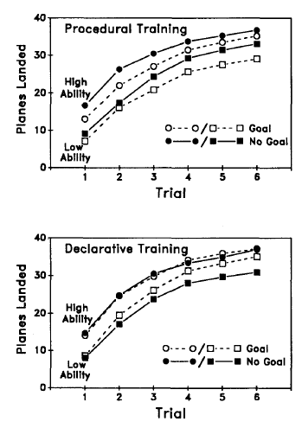
Is Goal Setting Always Helpful?
Kanfer & Ackerman (1989)
Air traffic controller study
Setting performance goals while still learning complex task hurt performance.
Setting performance goals when not in learning stage helped.
Winters & Latham (1996)
suggest setting learning goals as opposed to outcome goals in these situations.

Slide 29
Self-Efficacy
A person’s belief that he or she is capable of doing the activities required by the job.
Developed & increased by:
Mastery experiences
Modeling
Social persuasion
Physiological states
Ability
Self-Efficacy
Goal Setting
Performance

Slide 30
Self-Regulation
Self-regulation theories of motivation
Monitor behavior
Seek feedback
Responding to feedback
Forming beliefs about success of future endeavors
Control theory
Based on principle of feedback loop
Assumes individuals compare a standard to an actual outcome & adjust their behavior to bring outcome into agreement with a standard

Slide 31
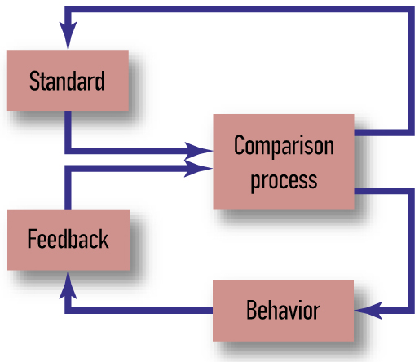
Self-Regulation
Simplified model of control theory

Slide 32
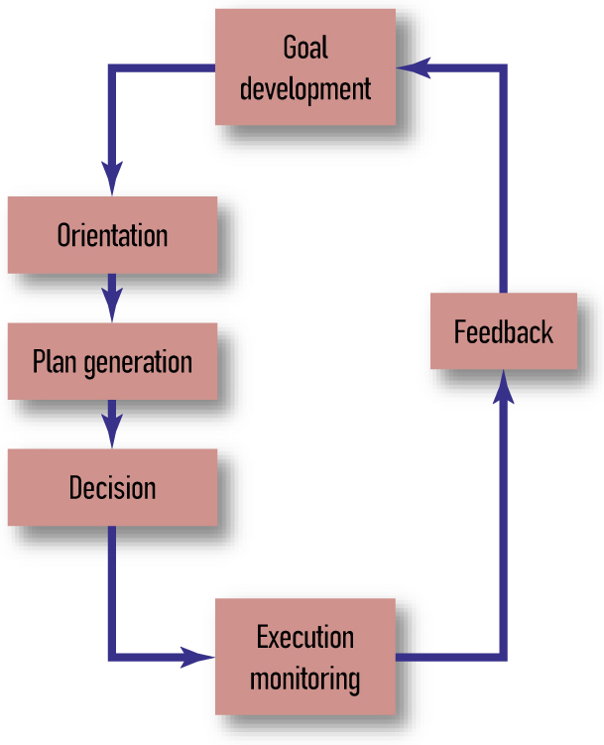
Action Theory (Rubicon theory)
Broad consideration of role of intention & connection between intention & action
Action phases in active goal pursuit
Predecisional
Postdecisional
Actional
Evaluative
It’s really just a variant of goal setting theory…

Slide 33
Practical Issues in Motivation
Module 8.4

Slide 34
Can Motivation be Measured
Yes
E.g., Motivational trait questionnaire (MTQ) measures 6 aspects of “general” motivation
Desire to learn
Mastery
Other-referenced goals
Competitiveness
Worry
Emotionality

Slide 35
Generational Differences & Work Motivation
Generation – defined by group members who share birth years & significant life events
e.g., Baby Boomers, Generation Xers, Generation Yers, Millennials
Initial Research indicates that:
Younger employees appear to be more “me” oriented
Today’s workers value “pride in work” less than workers of 1974
Work is less important now than 25 years ago
Work becomes less idealized as workers age

Slide 36
Motivational Intervention
Productivity Measurement & Enhancement System (ProMES)
Utilizes goal setting, rewards, & feedback to increase motivation & performance
Evidence shows significant gains in productivity following use of ProMES

